Slide 1
Azure Active Directory
Web Apps

Slide 2


Introduction
Bobby Bregman
Microsoft Certified Trainer since 2009
Working @ Motion10 since June 2014
Specialties (Infra & Development):
SharePoint since 2006
Lync since 2009
Office 365 since 2012
http://nl.linkedin.com/in/bobbybregman
@BobbyBregman

Slide 3
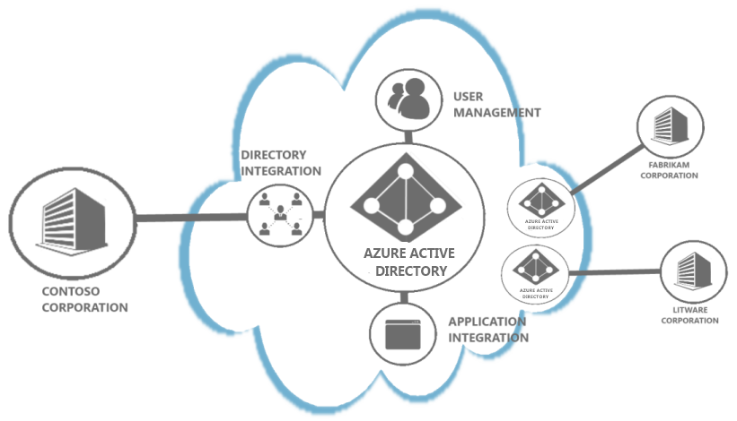
Agenda
What is Azure AD?
Azure Subscriptions, Resources, etc…
Identity approach
Labs

Slide 4























Microsoft Azure
^{app} ^{services}
cloud services
caching
identity
service bus
media
mobile services
web sites
integration
hpc
analytics
^{data} ^{services}
SQL database
HDInsight
table
blob storage
^{infrastructure} ^{services}
virtual machines
virtual network
vpn
traffic manager
cdn
Notes:
Microsoft Azure is a broad stack of services that runs in our datacenters globally.
Think of the different services as building blocks. These services can be categorized into three classes –
Infrastructure services which are lower level building blocks,
Data services that provide storage and data management capabilities to apps, and
App services which provide different capabilities to rapidly develop apps, scale and run apps at a global scale.

Slide 5

Microsoft Azure
Azure datacenters,
your datacenters.
^{app} ^{services}
cloud services
caching
identity
service bus
media
web sites
integration
hpc
analytics
virtual machines
virtual network
mobile services
vpn
^{data} ^{services}
SQL database
HDInsight
table
blob storage
^{infrastructure} ^{services}
virtual network
virtual machines
virtual network
vpn
traffic manager
cdn
vpn
Notes:
But that is not all that you can do with Azure. Microsoft Azure also provides infrastructure services which allow for more hands on configuration and management similar the servers you have today. However, they’re hosted in Microsoft datacenters letting you use Azure as if you were operating your own datacenter in the Cloud. For example, you can provision VMs, give them private IP addresses, and connect to them using a VPN from your on-premises environment. Most importantly, this lets Microsoft Azure mimic your on-premises datacenter and run your current apps with little or no change without the expense of having to own servers of racks, cooling and building costs. Furthermore, you can connect the “datacenter” you build in the Cloud to your on-premises datacenter so the datacenter in the Cloud becomes an extension to your on-premises infrastructure.
These “building blocks” lets Microsoft Azure to be used as an Infrastructure-a- a-service.
So, you see Microsoft Azure offers IaaS +PaaS in one platform. IaaS provides flexibility, PaaS eliminates complexity. Use PaaS where you can, use IaaS where you need. With Azure, you can use both together or independently, and build apps of the future. That uniquely differentiates us.

Slide 6
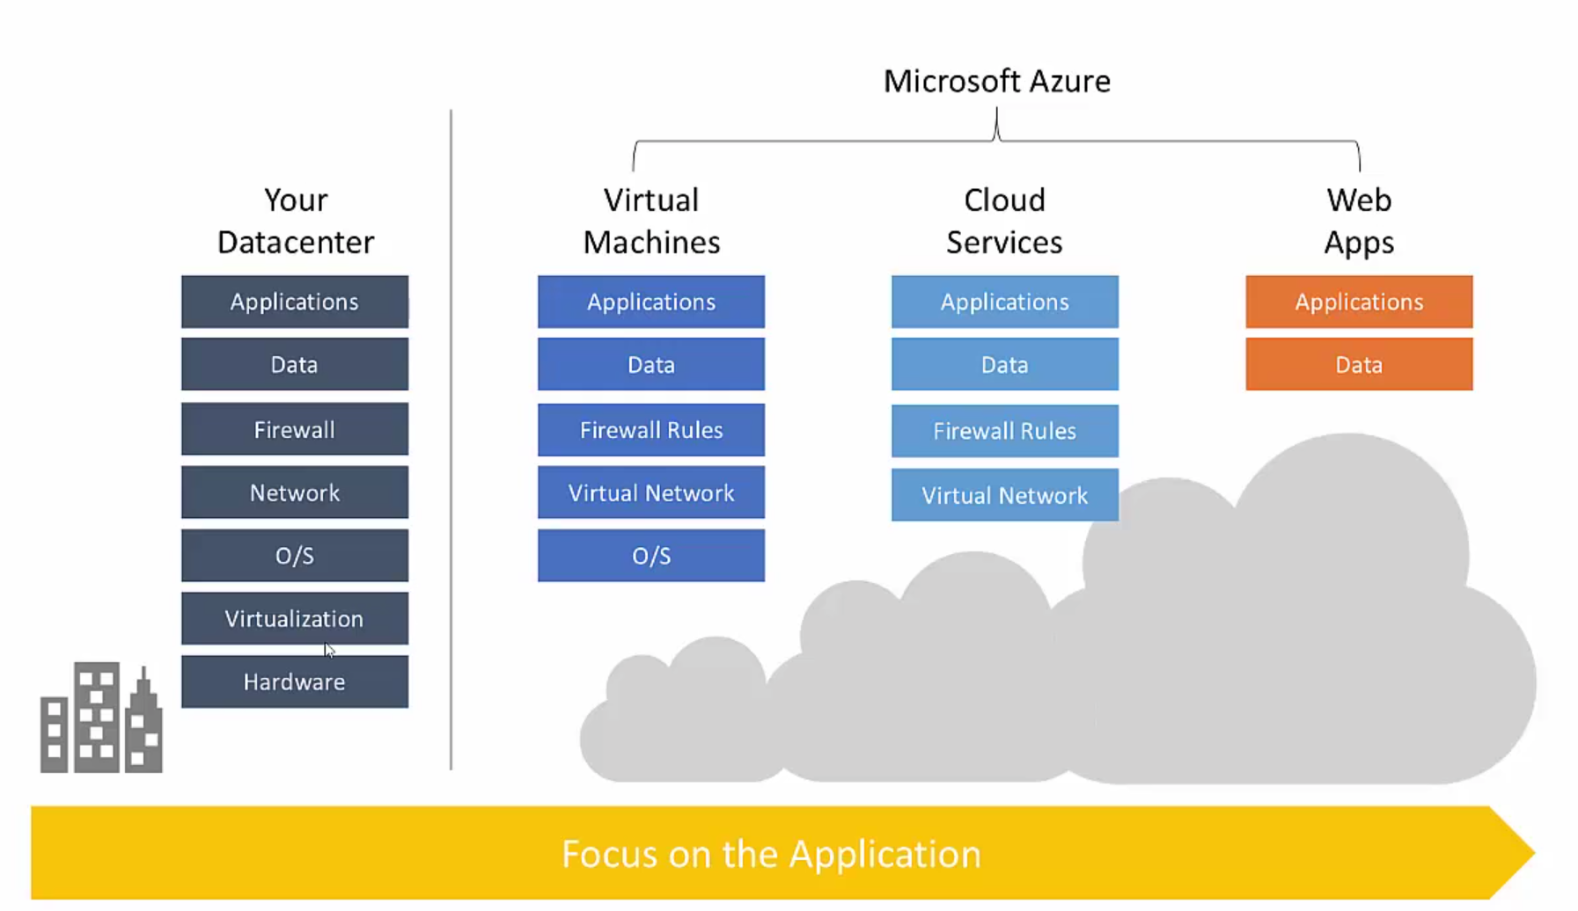

Slide 7
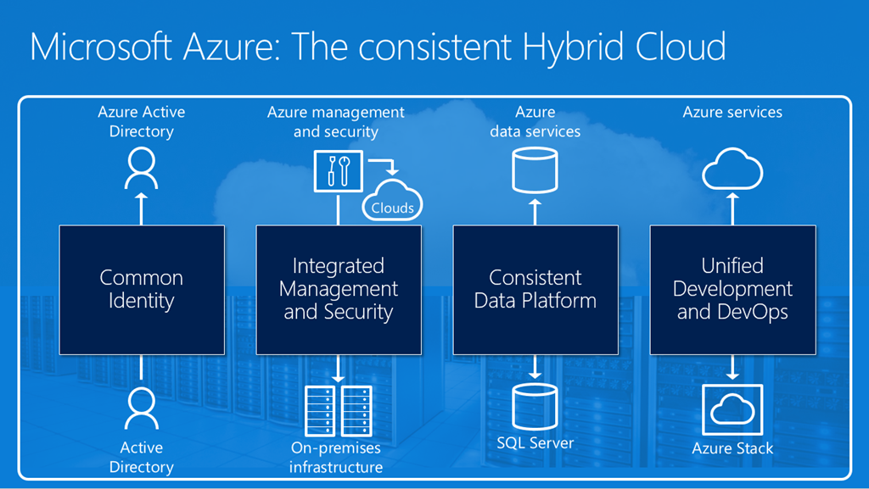
Azure – Hybride cloud

Slide 8



Microsoft Identity Approach
Administration
Authentication
Authorization
Audit
Capabilities:
Capabilities:
Capabilities:
Capabilities:
Identity Proliferation
Identity Integration
Convenience
Collection
Access logging
Entitlement Type
Provision & De-provision
Identity Updates
Sources
Synchronization
Password Management
Access Policies
Change logging
Alerting
Protocols
Group Management
Application Entitlement Management
Enforcement
Assurance
Reporting Methodology
Reporting Types
User Interface
Change Control
Based upon aka.ms/identity/4pillars

Slide 9
An Enterprise cloud governance structure
Enterprise Portal
Account Portal
Management Portal
Rest APIs
CLI / Custom
ARM Template
Visual Studio
Enterprise (Enrollment)
Azure Resource Manager (ARM)
Department
Department
Audit & operations
Azure Resource Groups
Azure Resource Groups
Account
Account
Subscription
Subscription
Azure Active Directory
RBAC, ABAC, B2B, B2C, Reporting, Strong AuthN, IDManagement
Advanced Identity & Access management functions
NSP
Internet
WAN
VPN
EXP
Synced & federated
OAuth2.0, OpenID Connect, SAML2.0
Customer premises
Datacenter(s)
SaaS
Azure
Public
cloud
Office 365

Slide 10
AAD - Architecture overview
Office 365
Azure Svcs
Dynamics
Intune
ISV apps
Custom IT apps
Apps
Admin
portal
Self Service
SaaS
App Mgmt
Azure AD
App proxy
Azure AD
Intelligence
On premise
Power
Shell
Device
registration
Information
Protection
DC as service
Azure AD Connect
Azure AD
Authentication
Svc
Directory graph
Svc
Synchronization Svc
Core Directory Store
AD
Directory partitions
P1
P2
…
Pn
Partitions partition

Slide 11
Azure Active Directory Editions
Common Features | Basic Only | Premium P1 | Premium P2
Directory Objects | Group-based access management / provisioning | Self-Service Group and app Management/Self-Service application additions/Dynamic Groups | Identity Protection
User/Group Management (add/update/delete)/ User-based provisioning, Device registration | Self-Service Password Reset for cloud users | Self-Service Password Reset/Change/Unlock with on-premises write-back | Privileged Identity Management
Single Sign-On (SSO) | Company Branding (Logon Pages/Access Panel customization) | Multi-Factor Authentication (Cloud and On-premises (MFA Server))
Self-Service Password Change for cloud users | Application Proxy | MIM CAL + MIM Server
Connect (Sync engine that extends on-premises directories to Azure Active Directory) | SLA 99.9% | Cloud App Discovery
Security / Usage Reports |  | Connect Health
 |  | Automatic password rollover for group accounts
Notes:
Self Service Password Reset
Users can reset their forgotten passwords in Azure AD and the new password can optionally be written back to the on-premises Active Directory
Self Service Group Management
Self-Service Group Management (SSGM) comprises two scenarios: Delegated Group Management and Self-Service Group Management

Slide 12





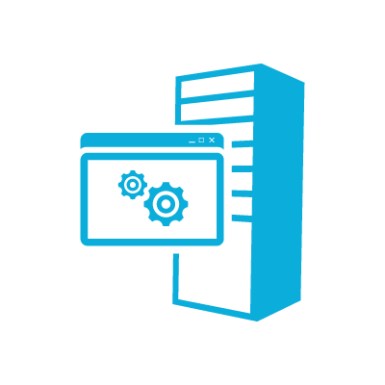


1
Users sign in from any device using their existing username/password.
2
Users must also authenticate using their phone or mobile device before access is granted.
On-Premises Apps
RADIUS
LDAP IIS
RDS/VDI
Cloud Apps
.NET, Java, PHP…
SAML
Multi-Factor
Authentication
Service
Multi-Factor
Authentication Server
Windows Azure
Active Directory
Windows
Active Directory
Windows Server AD or Other LDAP

Slide 13
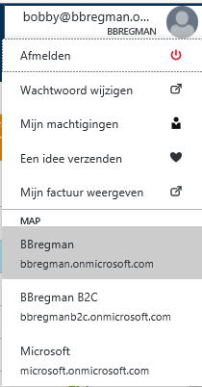
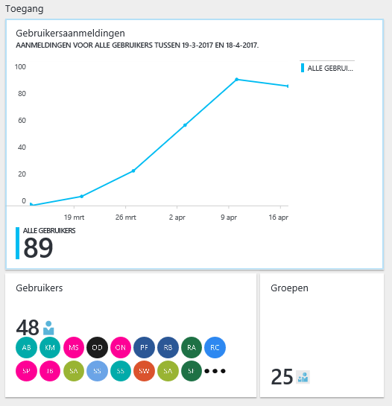
Demo
Bobby’s tenant -> BBREGMAN.onmicrosoft.com
Users
Groups
Synchronized and Cloud
External Users

Slide 14
Lab 1a - Create an Azure AD tenant of your choice
Azure AD Tenant creation:
Office365 trial?
MSDN Subscription with AAD Directory?
Test Subscription with AAD Directory?
First setup
Manage your subscription
Configure domains
Create admin accounts (and secure them with MFA)

Slide 15
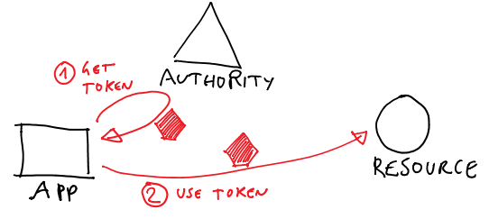
What Is Authentication?
Authentication is the process that verifies a user’s identity through:
Credentials, at least two components are required
Two types of authentication:
Local (interactive) log on to a local computer
Remote (network) log on for access to resources on another computer
Notes:
Define the authentication process. Use some real life examples to support and discuss the different types of authentication, such as local and remote. Also, discuss authentication on a local computer and describe what it means to join to a domain.
10969B
1: Overview of Access and Information Protection

Slide 16
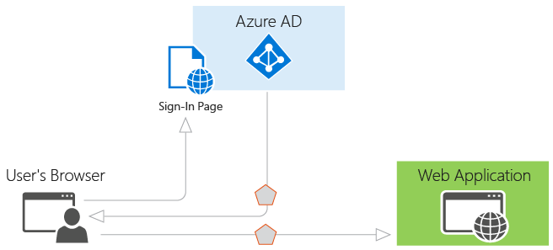
What Is Authorization?
Authorization is the process that determines whether to grant or deny a user a requested level of access to a resource
Three components are required for authorization:
Resource
Access request
Security token
AAD scenarios:
https://docs.microsoft.com/en-us/azure/active-directory/develop/active-directory-authentication-scenarios
Notes:
Define authorization. Discuss how the process works and use a shared folder as an example. Briefly mention Dynamic Access Control (DAC), but do not go into details.
10969B
1: Overview of Access and Information Protection

Slide 17



What Is Claims-Based Identity?
Claims provide information about users
Information is provided by the user’s identity provider and is accepted by the application provider
Security
Token
Service
Application
Security Token
(Outgoing
Claims)
Security Token
(Incoming
Claims)
Identity
Provider
Application
Provider
Notes:
Use this topic to describe how claims-based authentication makes it possible to implement identity federation.
As organizations define their business processes with partner organizations, they define which users are given access and what applications or data the users can access. Claims are a way to transmit agreed upon information between organizations. If the application provider wants to allow access based on specific groups or some other attribute, the identity provider has to make sure that information is included in the claims that are sent to the application provider.
10969B
10: Implementing and Administering AD FS

Slide 18



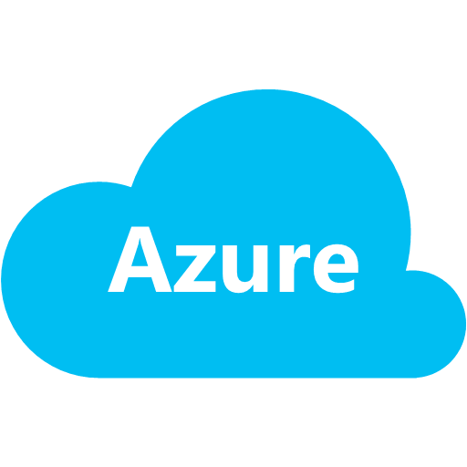


Active Directory vs. Azure AD
What is the difference?
Exchange
Online
SharePoint
Online
Graph API
Cloud Apps
Azure Active Directory
CLOUD
ON PREMISE
Active Directory
Exchange
SharePoint
LDAP
LOB Apps

Slide 19
AAD - Interfaces and Endpoints
DirSync
AAD Sync
Synchronization
Provisioning
Third party APIs
ADFS
Other IdP
SAML
OpenID Connect
Federation
Federation
Azure AD
Azure
PowerShell
Administration
Graph API
SDKs

Slide 20
Standards based integrations
Custom LOB applications that integrate with Azure Active Directory
Sign in to Active Directory-integrated applications with cloud identities
Active Directory-integrated applications can access Office 365 and other web APIs
Applications can extend Azure Active Directory schema
Cross-platform support (iOS, Android, and Windows)
Open Standards
(SAML, OAuth 2.0, OpenID Connect, Odata 3.0)
OAuth2 &
OpenID Connect
SAML
WS-Federation
REST based Graph API
Microsoft Azure
Active Directory
SCIM

Slide 21
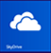


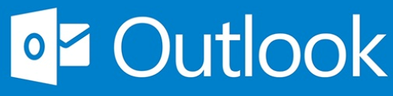


Microsoft Identities
Microsoft Account
Windows Azure Active Directory
Microsoft Account
Ex: alice@outlook.com
Organizational Account
Ex: alice@contoso.com
User
User

Slide 22
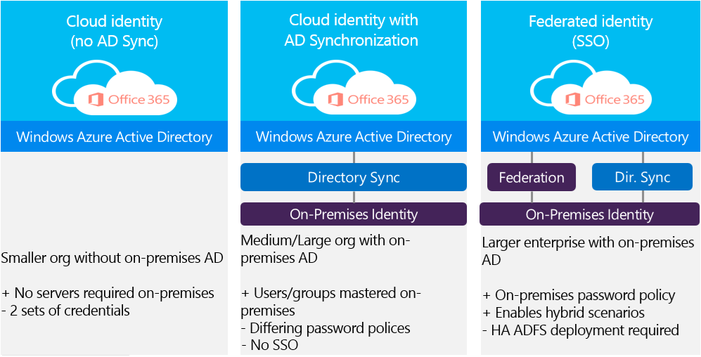
Office 365 Identity Models

Slide 23
Azure Active Directory Connect
Primary tool to onboard to Azure AD
Express Settings gets customers connected in a matter of minutes
Provides install & configuration of password sync/ADFS for sign-in
All future investments will only be available with Azure AD Connect
Azure AD Connect
DirSync
Azure AD Sync
Sync
FIM + Azure AD Connector
ADFS
Health
ADFS
Notes:
Sync Tools Include:
Azure AD Connect: Simple Scenarios
MM and the Azure AD Connector: Complex Scenarios
Previous Sync Tools: AAD Sync and DirSync – OLD – do not use anymore.
Consolidated deployment assistant for your identity bridge components.
All currently available sync engines will be replaced by the Sync engine included in the Connect tool.
Assisted deployment of ADFS will be available through Azure Active Directory Connect.
Authenticating to Azure AD
Enable password hash synchronization so that the Azure AD password for users is the same as the on-premises AD password
Otherwise, users will have different passwords for AD and Azure AD.
Authenticating to an On-Premises Identity Provider
Azure AD supports the ability to establish an identity federation trust with an on-premises Identity Provider (IdP), such as Active Directory Federation Services (AD FS).
This enables users to have a desktop Single Sign On experience when accessing resources that are integrated with Azure AD.

Slide 24
DEMO
AADConnect
ADFS environment
MFA

Slide 25
Lab 1b – create users and groups
Within your own AAD tenant create the following users:
Chris (Brown)
Michael (Jackson)
Jay (Leno)
Dries (Roelvink)
Within your own AAD tenant create the following groups:
Commercial Directors
Account Managers NL
Account Managers USA
Group memberships:
Jay is an account manager, just like Michael.
Dries is also an account manager
Chris is the commercial director

Slide 26






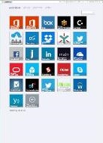
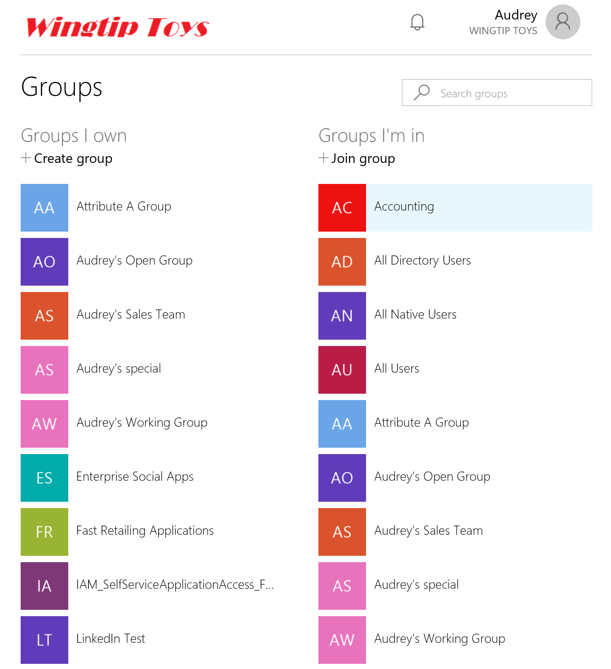

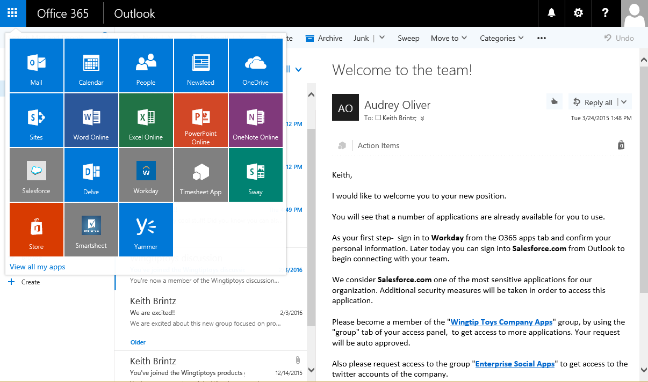
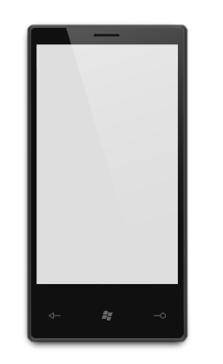
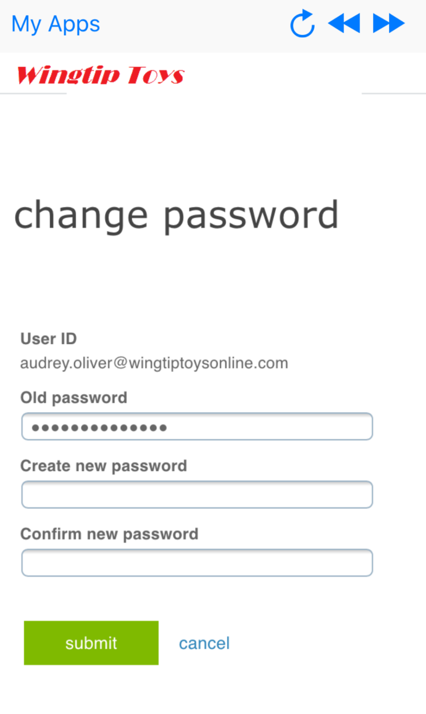
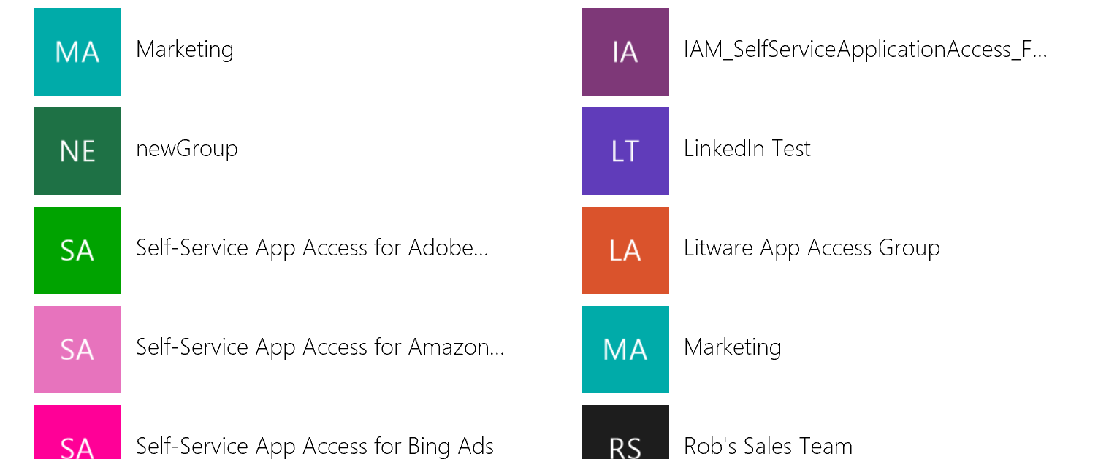
Productivity – Cloud and on-prem apps
Azure AD Application Integration
Real-time SSO and provisioning to the world’s most popular SaaS apps, from any device, integrated right into O365 experiences
HR Apps
On-premises
and hosted
Public Cloud
MIM
Easy-to use management UX means you can set up app access rules in minutes, rather than days. Delegate exceptions with self-service
SaaS
SSO + provisioning
Public
cloud
Immediate de-provisioning means users who don’t need access don’t keep it
Azure AD Connect
Windows Server
Active Directory
Azure AD app proxy works with PingAccess to integrate many more types of on-prem applications.
One click access
Conditional and risk-based access means access to your world of SaaS is secured with industry-leading machine-learning technology
Azure AD App Proxy
Azure Active Directory
Domain-based web apps

Slide 27
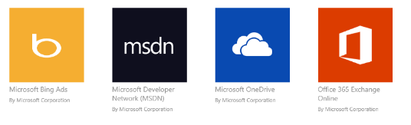
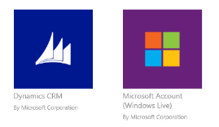
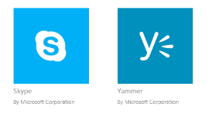
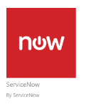
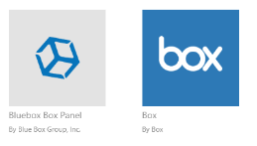
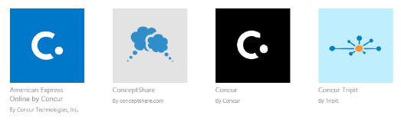
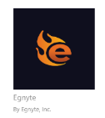


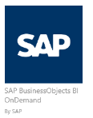
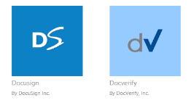
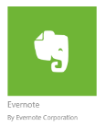
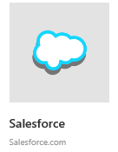

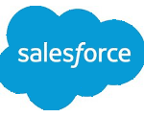
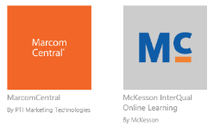
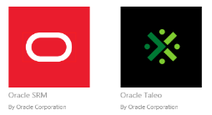
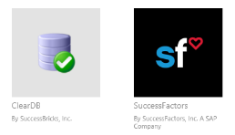

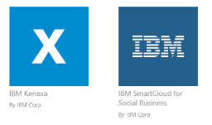

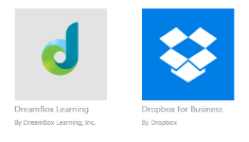




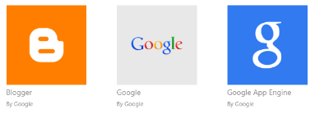

Thousands of pre-integrated apps and growing!

Slide 28
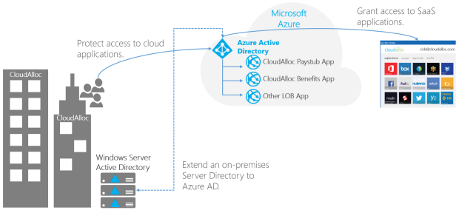
AAD & Apps

Slide 29
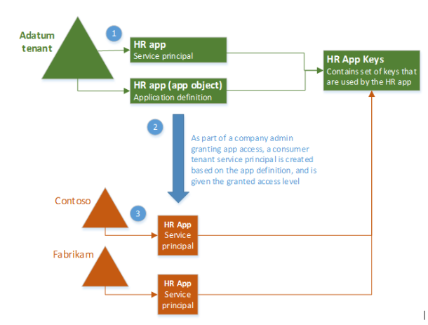
Apps & service principals
Application Definitions / Objects
Autorizations
Conditional Access
Service Principals
Keys
Permissions
URL’s

Slide 30
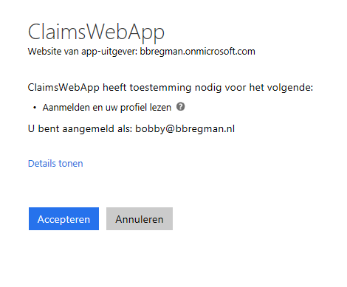
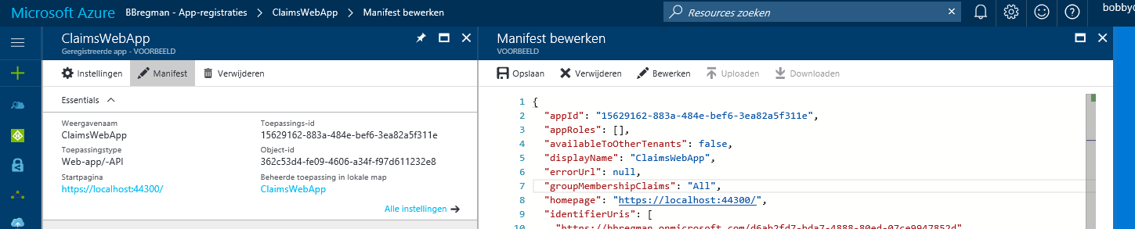
DEMO
App registrations
Autorizations (Admin demanded)
Consent

Slide 31
Lab 1c
Setup apps:
Get the Graph Explorer (https://graphexplorer.cloudapp.net) app to easily query your AAD tenant via the Graph API
Get the myapps app for your smartphone and sign in with your cloud user, can you see all your apps?
Download the Claims Webapp from github (https://github.com/ahelland/AADGuide-CodeSamples)
Register the app in Azure Active Directory
Change the manifest so groupmembershipclaims are shown in the app

Slide 32
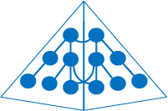
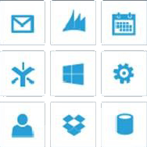



Identity Federation
Organizations can connect to SaaS applications running in Azure, Office 365 and 3rd party providers
Enhancements to AD FS include simplified deployment and management
SaaS Apps
Windows Server AD
Active Directory
Published applications
Web Application Proxy
(includes AD FS Proxy)
Active Directory Federation Services
Organizations can federate with partners and other organizations for seamless access to shared resources
Conditional access with multi-factor authentication is provided on a per-application basis, leveraging user identity, device registration & network location
Claims & Kerberos web apps
Office Forms Based Access
Resources in other businesses or identity realms
Active Directory Federation Services
Restful OAuth apps

Slide 33
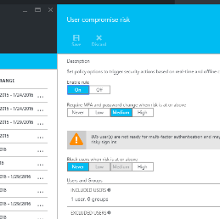
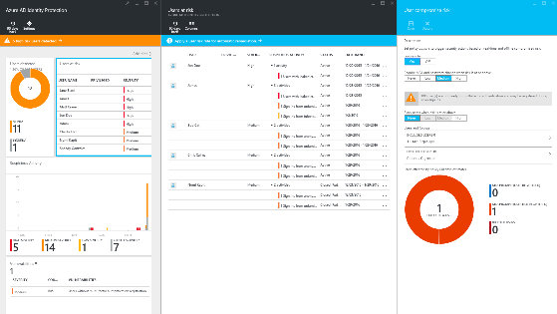
Azure Active Directory Identity Protection
Security service that provides a consolidated view into risk events and potential vulnerabilities affecting your organization’s identities based on an adaptive machine learning algorithms and heuristics to detect anomalies and risk events that may indicate that an identity has been compromised
Configuration vulnerabilities
Leaked credentials
Infected devices
Risk-based policies
Gain insights from a consolidated view of machine learning based threat detection
Suspicious sign-in activities
Brute force attacks
MFA Challenge Risky Logins
Remediation recommendations
Machine-Learning Engine
Change bad credentials
Risk severity calculation
Block attacks
Risk-based conditional access automatically protects against suspicious logins and compromised credentials
Notes:
Identity Protection generates reports and alerts that enables you to investigate these risk events and take appropriate remediation or mitigation action.
Identity Protection calculates a user risk level for each user, enabling you to configure risk-based policies to automatically protect the identities of your organization.
can automatically block or offer adaptive remediation actions that include password resets and multi-factor authentication enforcement

Slide 34
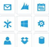

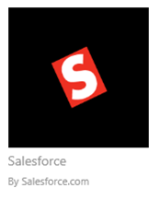

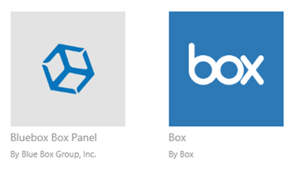
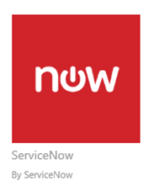
Conditional Access
User attributes
User identity
Group memberships
Devices
Is domain joined
Is compliant
Platform type
Not lost/stolen
Application
Per-service
Managed client app
Allow
Block
MFA
Enroll
Other
Location (IP range)
Risk profile
On-Premises applications

Slide 35



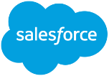







Introducing Microsoft Cloud App Security
Enterprise-grade security for your cloud apps
Cloud-delivered service bringing visibility and control to cloud apps
Committed to support third-party cloud apps
Based on the Adallom acquisition
Available as: standalone and in EMS E5 (Oct 1, 2016)

Slide 36


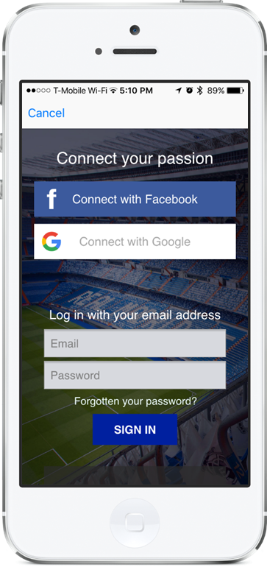
Real Madrid
Seamless user experience on mobile & web apps
Fully customized sign-up & sign-in pages without custom code
Alleviated concerns about security, data breaches, and scalability
“Azure Active Directory B2C helps us bring the stadium closer to our 450 million fans around the globe with simplified registration and login through social accounts, like Facebook, or traditional username/passwords login.”
– Rafael De Los Santos, Digital Head, Real Madrid

